Slide 1

Sensor Fusion

Slide 2
Sensors
The ISM330DHCX has a 3D accelerometer range of ±2/±4/±8/±16 g. The 3D gyroscope angular rate range of ±125/±250/±500/±1000/±2000/±4000 dps.
MMC5983MA
The H3LIS331DL is a high-g, low-power, high-performance 3-axis linear accelerometer.

Slide 3
Connection modes
The device offers four different connection modes, described in detail in this document:
Mode 1: it is the connection mode enabled by default; I²C slave interface or SPI (3- / 4-wire) serial interface is available.
Mode 2: it is the sensor hub mode; I²C slave interface or SPI (3- / 4-wire) serial interface and I²C interface master for external sensor connections are available. This connection mode is described in Section 7 Mode 2 - Sensor hub mode.
Mode 3: in addition to the primary I²C slave interface or SPI (3- / 4-wire) serial interface, an auxiliary SPI (3- / 4-wire) serial interface for external device connections (i.e. camera module) is available for the gyroscope only. This connection mode is described in Section 8 Mode 3 and Mode 4 - Auxiliary SPI modes.
Mode 4: in addition to the primary I²C slave interface or SPI (3- / 4-wire) serial interface, an auxiliary SPI (3- / 4-wire) serial interface for external device connections is available for both gyroscope and accelerometer. This connection mode is described in Section 8 Mode 3 and Mode 4 - Auxiliary SPI modes.

Slide 4
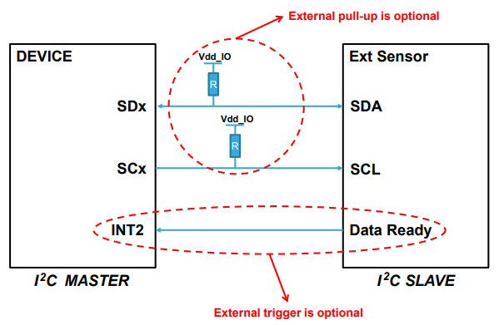
Sensor Hub
sensor hub mode (Mode 2) up to 4 external sensors
sensor hub trigger signal can be synchronized with the accelerometer/gyroscope data-ready signal (up to 104 Hz)
If both the accelerometer and the gyroscope are in Power-Down mode, the sensor hub does not work. All external sensors have to be connected in parallel to the SDx/SCx pins of the device
https://www.youtube.com/watch?v=uRnM-tbyy1I

Slide 5
Sensor hub mode registers
SHUB_REG_ACCESS of the FUNC_CFG_ACCESS register = 1.
MASTER_CONFIG register has to be used for the configuration of the I²C master interface.
A set of registers SLVx_ADD, SLVx_SUBADD, SLAVEx_CONFIG is dedicated to the configuration of the 4 slave interfaces associated to the 4 connectable external sensors.
18 registers (from SENSOR_HUB_1 to SENSOR_HUB_18) are available to store the data read from the external sensors.

Slide 6
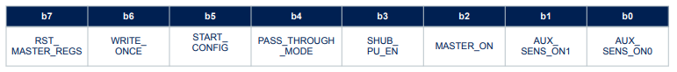
MASTER_CONFIG (14h)
RST_MASTER_REGS bit is used to reset the I²C master interface, configuration and output registers.
The WRITE_ONCE bit must be set to 1 if the slave 0 is used for reading
START_CONFIG When this bit is set to 0, the accelerometer/gyroscope sensor has to be active and the sensor hub trigger signal is the accelerometer/gyroscope data-ready signal. When this bit is set to 1, at least one sensor between the accelerometer and the gyroscope has to be active and the sensor hub trigger signal is the INT2 pin. In fact, when both the MASTER_ON bit and START_CONFIG bit are set to 1, the INT2 pin is configured as an input signal.
PASS_THROUGH_MODE bit is used to enable/disable the I²C interface pass-through. When this bit is set to 1, the main I²C line (e.g. connected to an external microcontroller) is short-circuited with the auxiliary one,
SHUB_PU_EN bit this bit is set to 1, the internal pull-up is enabled (regardless of the configuration of the MASTER_ON bit) and the external pull-up resistors on the SDx/SCx pins are not required.
Wait 300 µs.
AUX_SENS_ON[1:0] bits have to be set accordingly to the number of slaves to be used. I²C transactions are performed sequentially from slave 0 to slave 3. The possible values are:
– 00b: one slave; – 01b: two slaves; – 10b: three slaves; – 11b: four slaves.

Slide 7
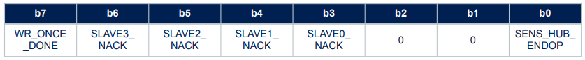
STATUS_MASTER (22h)
WR_ONCE_DONE bit is set to 1 after a write operation performed with the WRITE_ONCE bit configured to 1 in the MASTER_CONFIG register
SLAVEx_NACK bits are set to 1 if a “not acknowledge” event happens during the communication with the corresponding slave x.
SENS_HUB_ENDOP bit reports the status of the I²C master: during the idle state of the I²C master, this bit is equal to 1; it goes to 0 during I²C master read/write operations.
When a sensor hub routine is completed, this bit automatically goes to 1 and the external sensor data are available to be read from the SENSOR_HUB_x registers (depending on the configuration of the SLVx_ADD, SLVx_SUBADD, SLAVEx_CONFIG registers). Information about the status of the I²C master can be driven to the INT1 interrupt pin by setting the INT1_SHUB bit of the MD1_CFG register to 1.This signal goes high on a rising edge of the SENS_HUB_ENDOP signal and it is cleared only if the STATUS_MASTER / STATUS_MASTER_MAINPAGE register is read.

Slide 8


SLV0_SUBADD register & SLV0_SUBADD register
slave0_add[6:0] bits are used to indicate the I²C slave address of the first external sensor.
rw_0 bit configures the read/write operation to be performed on the first external sensor (0: write operation; 1: read operation). The read/write operation is executed when the next sensor hub trigger event occurs.
slave0_reg[7:0] bits are used to indicate the address of the register of the first external sensor to be written (if the rw_0 bit of the SLV0_ADD register is set to 0) or the address of the first register to be read (if the rw_0 bit is set to 1).

Slide 9
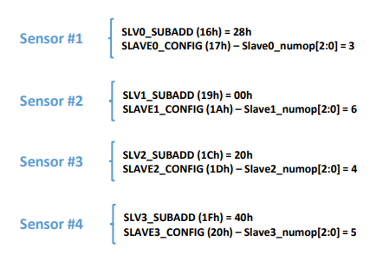

Slide 10
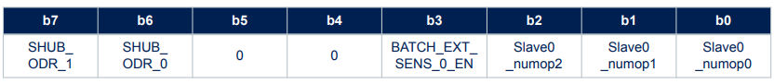
SLAVE0_CONFIG register
SHUB_ODR_[1:0] bits are used to configure the sensor hub output data rate when using internal trigger (accelerometer/gyroscope data-ready signals). The sensor hub output data rate can be configured to four possible values, limited by the ODR of the accelerometer and gyroscope sensors:
– 00b: 104 Hz; – 01b: 52 Hz; – 10b: 26 Hz; – 11b: 12.5 Hz.
BATCH_EXT_SENS_0_EN bit is used to enable the batching in FIFO of the external sensor associated to slave0
Slave0_numop[2:0] bits are dedicated to define the number of consecutive read operations to be performed on the first external sensor starting from the register address indicated in the SLV0_SUBADD register.

Slide 11
First-in, first-out (FIFO) buffer
The ISM330DHCX embeds a 3 kbyte (up to 9 kbyte with the compression feature enabled) first-in
The FIFO can be configured to store the following data:
Main sensors, which are physical sensors:
gyroscope sensor data;
accelerometer sensor data;
Auxiliary sensors, which contain information of the status of the device:
timestamp data;
temperature sensor data;
Virtual sensors:
external sensor (connected to sensor hub interface) data;
step counter (and associated timestamp) data.
Saving the data in FIFO is based on FIFO words. A FIFO word is composed of :
tag, 1 byte
data, 6 bytes

Slide 12
Six different FIFO operating modes
Bypass mode;
FIFO mode;
Continuous mode;
Continuous-to-FIFO mode;
Bypass-to-Continuous mode;
Bypass-to-FIFO mode.

Slide 13
FIFO compression
FIFO compression is an embedded algorithm that allows storing up to 3 times the number of accelerometer and gyroscope data in FIFO. The compression algorithm automatically analyzes the slope of the sensor waveform and applies the compression of data in FIFO on the basis of the slope (difference between two consecutive samples)
1. Both accelerometer and gyroscope are batched in FIFO and max(ODR_XL, ODR_G) ≥ 1.66 kHz;
2. Accelerometer only or gyroscope only is batched in FIFO and max(ODR_XL, ODR_G) ≥ 3.33 kHz.
FIFO compression supports three different levels of compression:
• NC, not compressed, if the difference between the actual and previous data is higher than 128 LSB: one sensor sample is stored in one FIFO word;
• 2xC, low compression, if the difference between the actual and previous data between 16 and 128 LSB: two sensor samples are stored in one FIFO word;
• 3xC, high compression, if the difference between the actual and previous data is less than 16 LSB: three sensor samples are stored in one FIFO word.

Slide 14
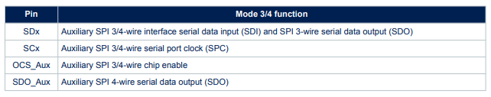
Auxiliary SPI modes
If Mode 4 is enabled (by setting the Mode4_EN bit of the CTRL1_OIS register to 1 and with gyroscope OIS chain enabled), the accelerometer output values are available at 6.66 kHz ODR through the Auxiliary SPI interface in addition to the gyroscope values.

Slide 15
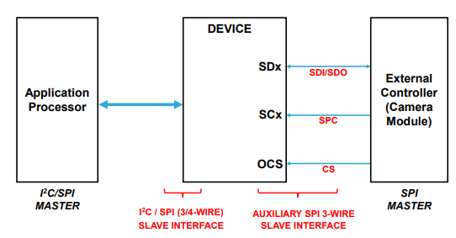
SPI

Slide 16
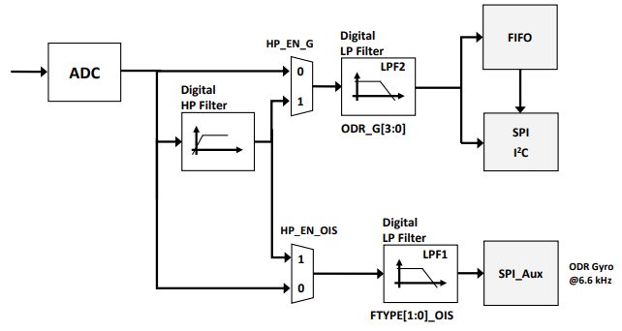
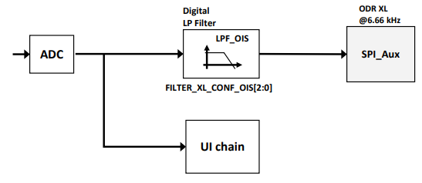
Filtering availability
Gyroscope filtering chain (Mode 3 / Mode 4)
. Accelerometer filtering chain (Mode 4)

